Slide 1
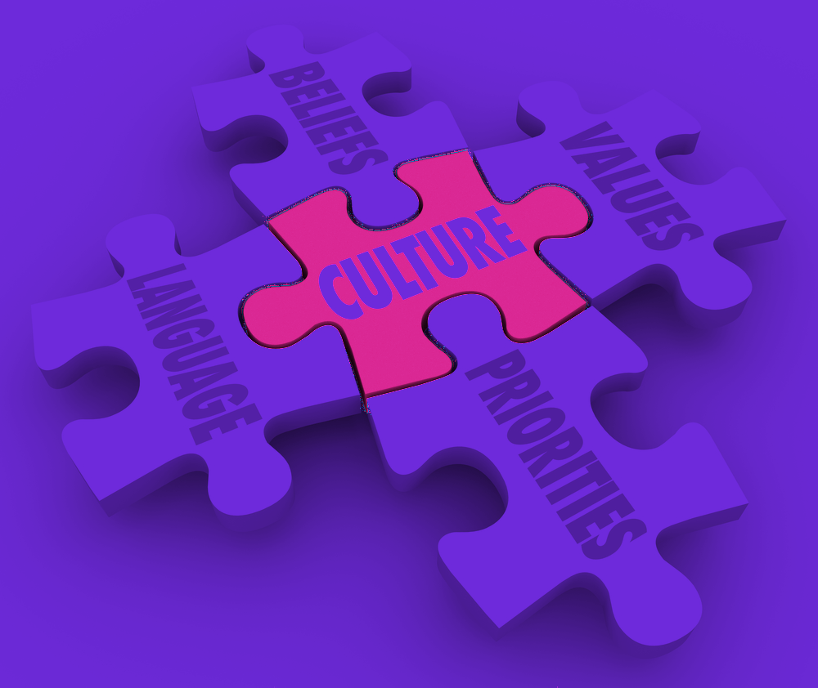
Impact of language on culture.
By:
Muhammad Ahmad.

Slide 2

Language.
Language is a system of speech, manual or written words that humans use to communicate.
The roots of human language remain a mystery. Yet there is no record to show how language started.

Slide 3
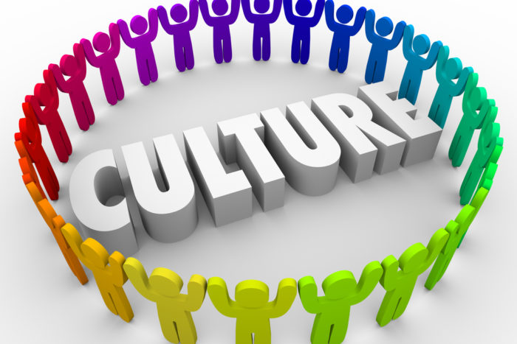
Culture.
Culture is defined as the blend of thought patterns and characteristics of a group of people.
Culture teaches us how to think and communicate with others

Slide 4
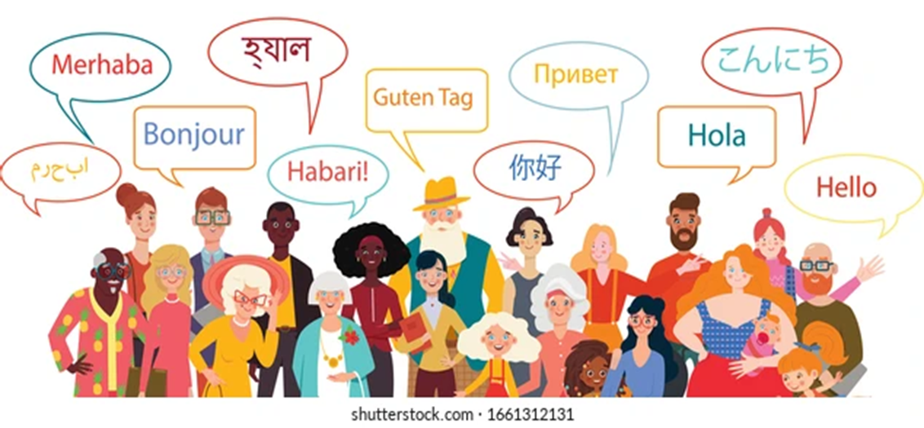
Language & Culture.
Language is one of the most important part of any culture.
There are 6500 languages that are spoken.
It combines our social relationship and social system.
It act as a link to transfer
knowledge.

